Slide 1
Auto-mate Project
Find automatic mating pars based on surface selection

Slide 2
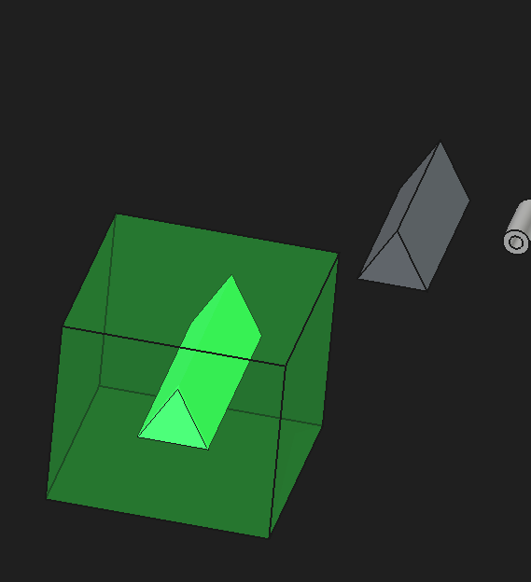
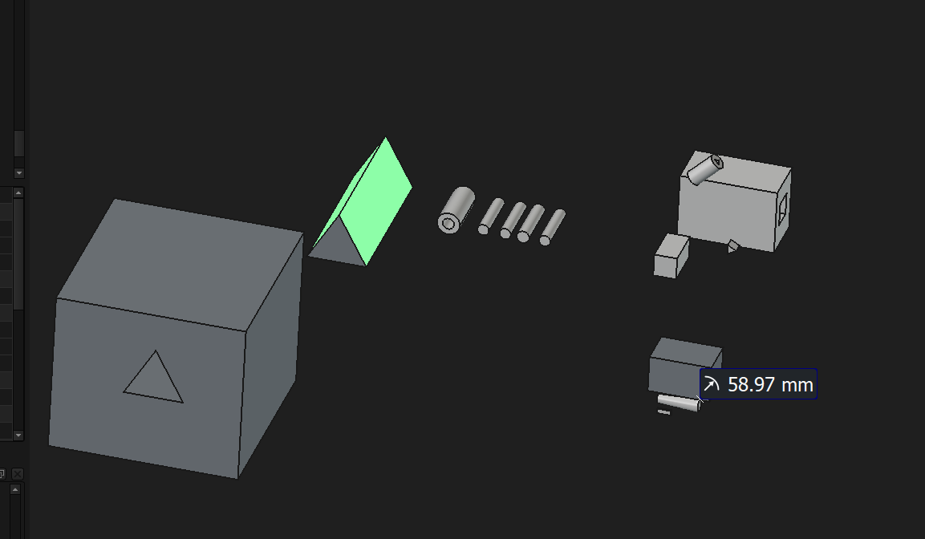

Example 1
Matching faces highlighted in bright green
Mate
Dump Report
Result
Face Selection

Slide 3
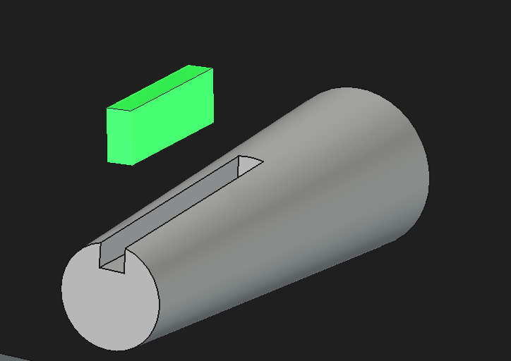
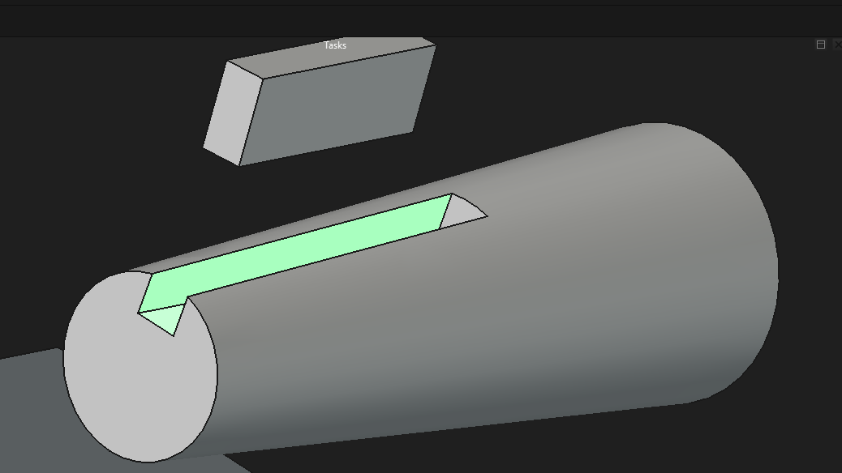

Example 2
Mate
Face Selection
Result

Slide 4
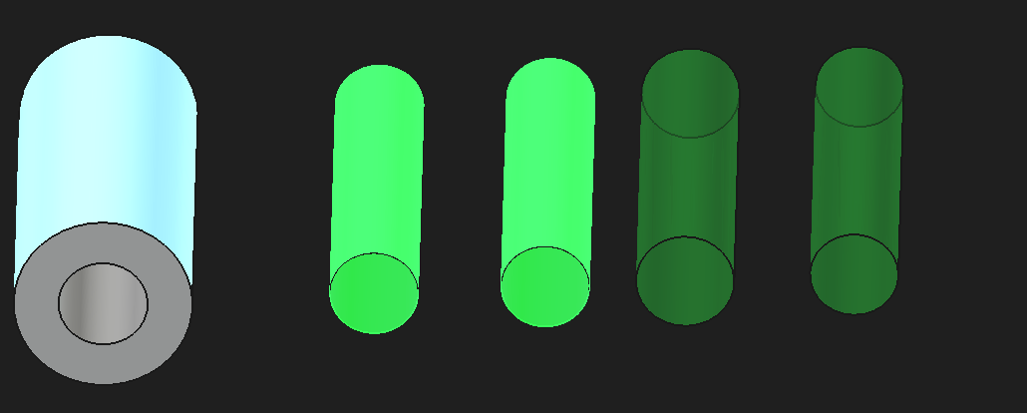
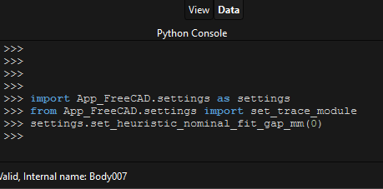

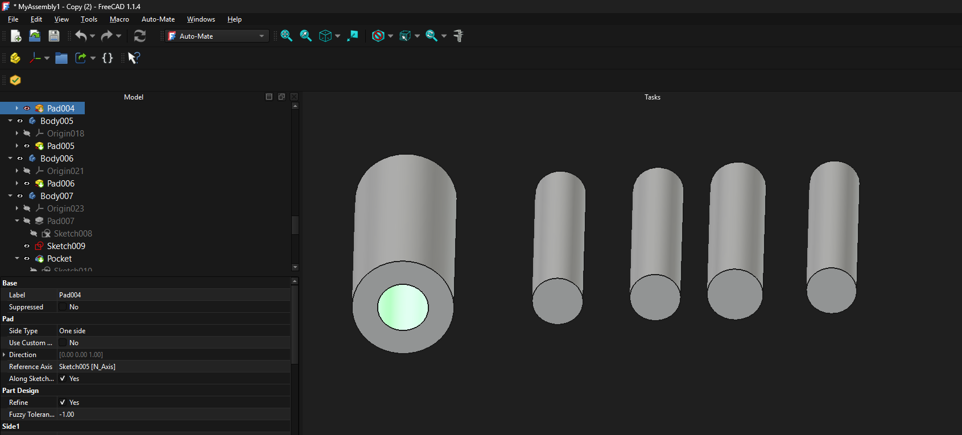
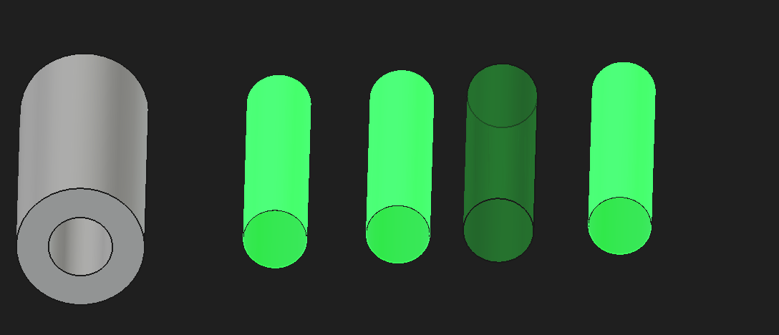


Example 3: Considering clearance - Exact and clearance fits
Fit allowance 0mm
Mate
Mate
Fit allowance 2mm

Slide 5
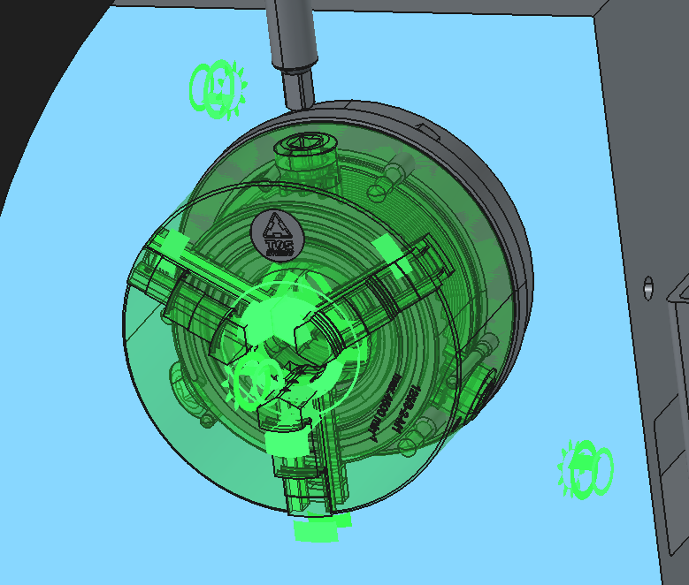
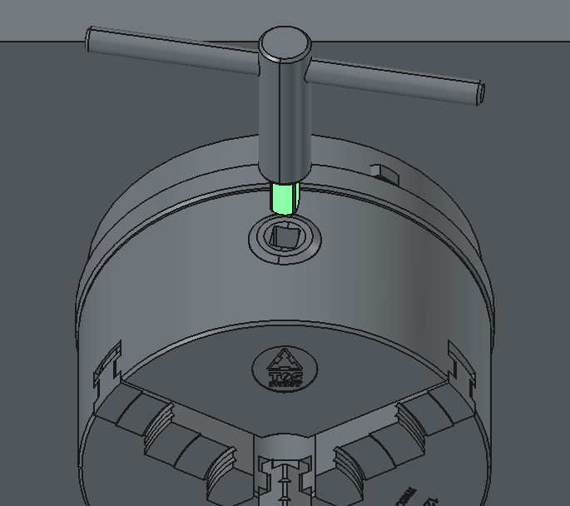
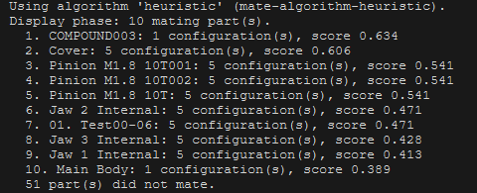
Example 4
Rendering of “Pinions” (and many others) are messed up for some unknown reason.
Mate
Face Selection

Slide 6
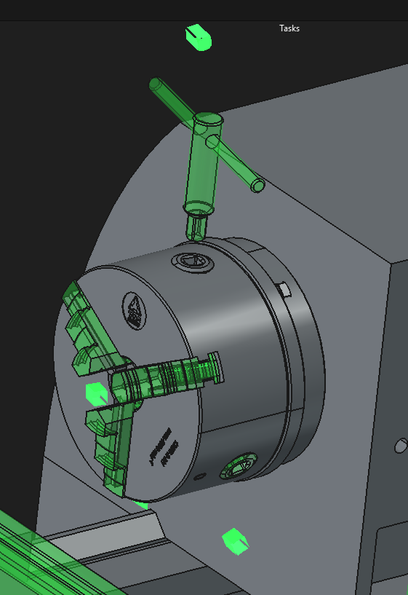
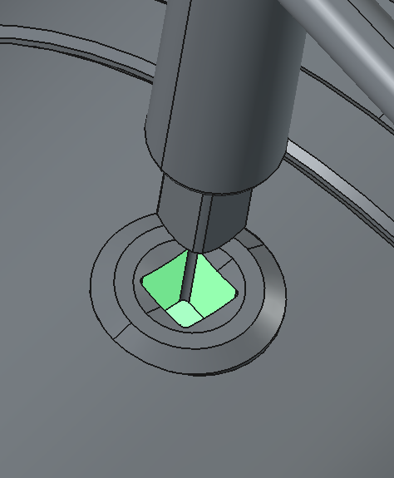
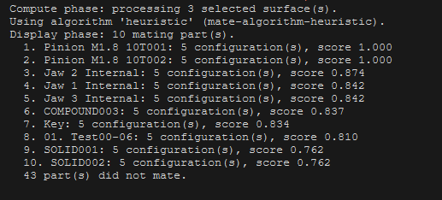
Example 4 - contd
Mate
Face Selection

